Slide 1


Sponsorship

Slide 2

Strategic Highway Investment Formula for Tomorrow
  PROJECTS INCLUDED
    Safety Improvements
    Road Widening
    Reconstruction
    New Routes and Interchanges
PROJECTS OUTSIDE SHIFT
  Rural and Municipal Aid
  Maintenance Work
  Federally Dedicated Projects
  MPO Dedicated Projects
Notes:
About half of our transportation funding priorities will be part of the SHIFT process. This includes safety improvements, road widening, reconstruction, new routes and interchanges. The other half of funding priorities will be determined outside of SHIFT. This includes Rural and Municipal Aid, federally dedicated projects including maintenance, MPO, safety, bike/ped and congestion funding.
Projects Included*
Capital Improvement Projects:
Widening, Relocation, New Routes, Spot Improvements
Projects Excluded*
Asset Management : Bridge Replacement / Repair, Pavement Replacement / Repair, Weigh Station Repair, Rest Area Repair etc…
Operations: Ferry, ITS, Lighting, Signal Sys Improvement
Dedicated Funds such as:DAR, CM, FH, SHN, SLO, SNK, SLX, SAH, TAP, SAF, RRP, TE, SRS, RRS, RRP
Also - Bike/Ped or other Transportation
Accounting Funds: Prefinanced Conversion, Matched Fed funds
Z Various

Slide 3
Highway Plan Projects – Committed Projects
  Were in the Recommended Highway Plan.
  Have either R, U, or C programmed in the biennium (2018-2020) of the Enacted Plan or only C programmed in 2021-2024 of the Enacted Plan (and no other phase in the Plan).
  Have consistent scope with what was proposed in 2018
      - costs within 5%
      - R programmed in the biennium is on schedule for funding authorization w/in the biennium
Notes:
Out of a total of 456 projects: This includes all projects in the Enacted Plan with funding type of NH, STP, SPP, or BR2 (BRAC).
83 committed projects
313 projects need to be sponsored
3 mega do not sponsor
49 Let / Awarded and 4 with C authorized in T3&4

Slide 4
Highway Plan Projects – Sponsorship
ALL other projects in SHIFT need to be sponsored to be included in prioritization.
Projects with active phases still need to be sponsored to be included.
Each project construction segment will need to be sponsored.
Notes:
All projects in SHIFT need to be sponsored. No project was automatically moved forward.
Projects with authorized phases still need sponsorship to move forward.
Each construction segment will need to be sponsored individually.
Projects with scheduled lettings should still be sponsored. If the letting is next month you are probably OK, If the letting is July you may want to hedge your bet.

Slide 5
Highway Plan Projects - Families
Item #’s can be grouped into project families for scoring on one CHAF.
Projects must be combined to obtain independent utility/ benefit (i.e. a new road should not stop in a field, but tie back into the network).
The entire family’s R, U, and C cost will be combined.
All projects covered by a single environmental document could be combined.
All associated projects in a family will be evaluated by the overall family data and score.
The schedules for individual construction sections will be considered during the programming step with dates gathered from SYP or in consultation with District Offices.

Slide 6
CHAF Projects / New Projects- Sponsorship
New projects can be sponsored until 3/15/19
New CHAFs can be created until 3/1/19
To sponsor a project it must be entered in CHAF
All of the current Highway Plan projects are in CHAF
Notes:
On the PIF side any new project can be sponsored as long as it fits under the SHIFT project umbrella mentioned on the 2nd slide. New PIFs can still be entered at this time.
To sponsor a project it must first be entered in PIF.

Slide 7
SHIFT Prioritization and Reporting Websites
  http://pmtoolbox.kytc.ky.gov/AddScore.html
  http://pmtoolbox.kytc.ky.gov/DistScore.html
  http://pmtoolbox.kytc.ky.gov/MPOScore.html
  Project lists posted

Slide 8
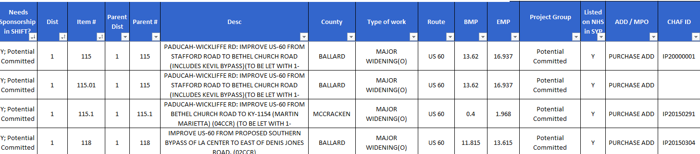
2018 Highway Plan Project File
Projects eligible for sponsorship
CHAF ID for each Item #, there may be multiple
NHS “Y” if >50% of the project is on a NHS route
Notes:
Projects not sponsored:
Of all SHIFT eligible projects in the Enacted Plan with funding type of NH, STP, SPP, or BR2 (BRAC) do not sponsor:
Let/Awarded projects
Committed projects
Mega Projects
Project groups outside of SHIFT:
Z Various
Asset Management - Bridges, Pavement
Cash Flow - Prefinanced Conversion or Matched Federal Funds
Dedicated Funds- Safety, MPO funds, Congestion Mitigation etc...
Miscellaneous & Operations Projects - filtered out by project type

Slide 9
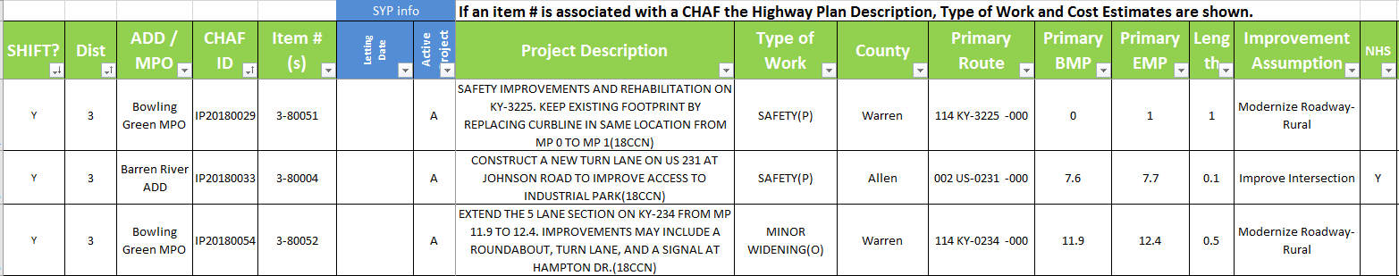
Active CHAF File
Projects eligible for sponsorship
SYP information for projects with item #’s
Displays the 1st route information
NHS “Y” if >50% of the project is on a NHS route
Notes:
SHIFT? - Y/N
CHAF only projects ( no item #)
The SHIFT ? column (column A) marked CHAF projects with “Y” or “N” based upon the type of work in CHAF. If there is not a type of work selected a “?” was entered. Type of work that are marked with a “Y” are:
CHAF Type of Work that is relative to SHIFT
Air Quality (P)
Bypass
Congestion Management
Economic Development
Major Widening
Minor Widening
New Interchange
New Route
Reconstruction
Relocation
Safety-Haz-Elm
Spot Improvement
CHAF projects with item #’s
Only item #’s from the current plan can be sponsored. If an item # is on a CHAF from a previous plan and the project needs to be sponsored, the item # needs to be removed and the estimates added to the CHAF.
The SHIFT ? column (column A) marked CHAF projects with “Y” or “N” based upon whether the project is committed, the type of work and the fund code listed in the Highway Plan (SYP).

Slide 10
2020 Sponsorship Allowances
District | # to Sponsor |  | ADD | # to Sponsor |  | MPO | # to Sponsor
1 | 50 |  | BARREN RIVER | 40 |  | Bowling Green | 10
2 | 56 |  | BIG SANDY | 23 |  | Evansville | 6
3 | 48 |  | BLUEGRASS | 67 |  | Louisville | 54
4 | 52 |  | BUFFALO TRACE | 16 |  | KYOVA | 10
5 | 74 |  | CUMBERLAND VALLEY | 38 |  | Lexington | 23
6 | 53 |  | FIVCO | 16 |  | OKI | 27
7 | 68 |  | GATEWAY | 18 |  | Owensboro | 9
8 | 45 |  | GREEN RIVER | 23 |  | Radcliff | 12
9 | 40 |  | KENTUCKY RIVER | 29 |  | Clarksville | 3
10 | 35 |  | KIPDA | 22
11 | 37 |  | LAKE CUMBERLAND | 43
12 | 31 |  | LINCOLN TRAIL | 30
 |  |  | NORTHERN KENTUCKY | 23
 |  |  | PENNYRILE | 41
 |  |  | PURCHASE | 36
Notes:
A project must be sponsored to be scored…..
Area Development Districts, Metropolitan Planning Organizations, and KYTC Highway District Offices can sponsor projects for scoring.
The number of sponsorships for each of those groups is determined by the number of counties, population, and lane miles within the jurisdiction of these agencies.
For SHIFT 2018 (the first round of SHIFT), this approach allowed for about 1200 projects to be sponsored.
Sponsorship # = 2*Number of Counties + Population/25000 + Lane Miles/1000
Updated to 2010 Census numbers and recalculated numbers for all entities
Data Management provided Public Road Lane miles for all entities

Slide 11

Sponsorship Phase Key Points
Projects may be sponsored between 1/2/19 – 3/15/19.
Projects must be in CHAF in order to be sponsored.
New CHAF project requests may be submitted up through 3/1/19.
CHAF will be locked for editing in “read only” mode after the sponsorship cycle beginning 3/16/19.
CHAF will be unlocked for specific edits on sponsored projects during the SHIFT cycle for data verification. (i.e. estimates, improvement type, project type etc.)
3/25/19 – 3/29/19 - ADDs, MPOs and Districts conference calls with C.O. Planning to discuss sponsored projects.

Slide 12
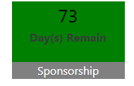
How to Sponsor a Project in CHAF
Click on the number in the sponsorship tile to enter the sponsorship screen
Notes:
If the sponsorship period is open you will see a green sponsorship tile on the Home screen.
To get to the sponsorship page click on the # ( the tile is not linked, you will need to click on the #)

Slide 13

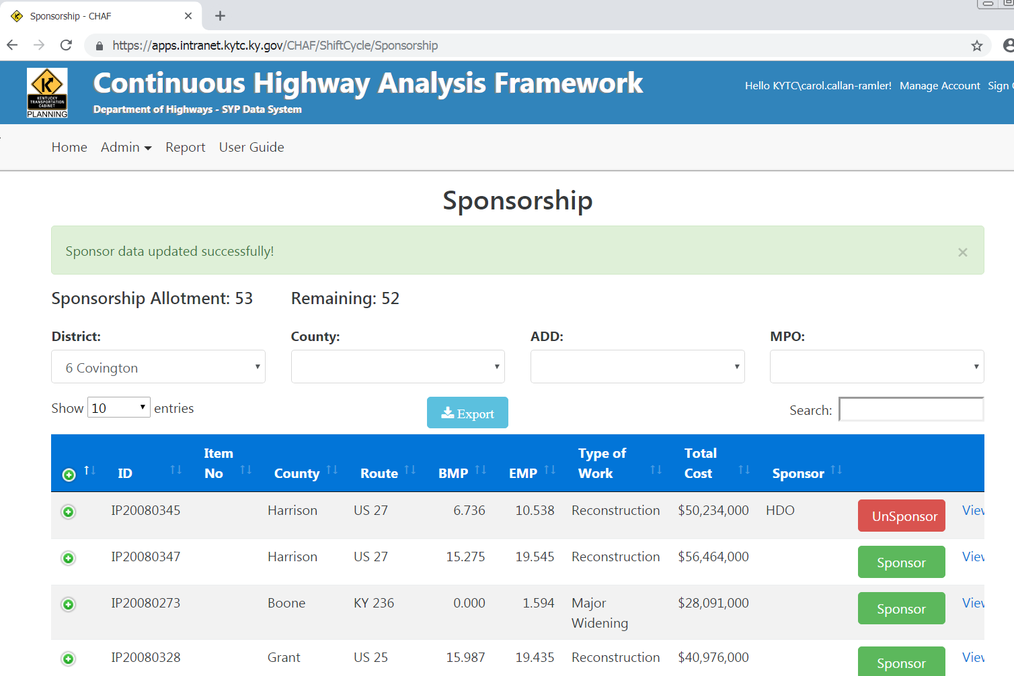
Notes:
The sponsorship screen will appear.
The project list will be comprised of projects in your organizational area.
If a project has been sponsored you will see a red button next to it with the word unsponsor
If a project has not been sponsored you will see a green button with the word sponsor.
Click on all the projects you would like to sponsor.
Every organization has an # of sponsorship allowances. Once you have sponsored the # of projects allowed you will not be able to sponsor any more. In this case, you will have to unsponsor a project in order to free up a spot to sponsor another.

Slide 14
Notes:
To get a list of all projects in your area click on the export button.

Slide 15
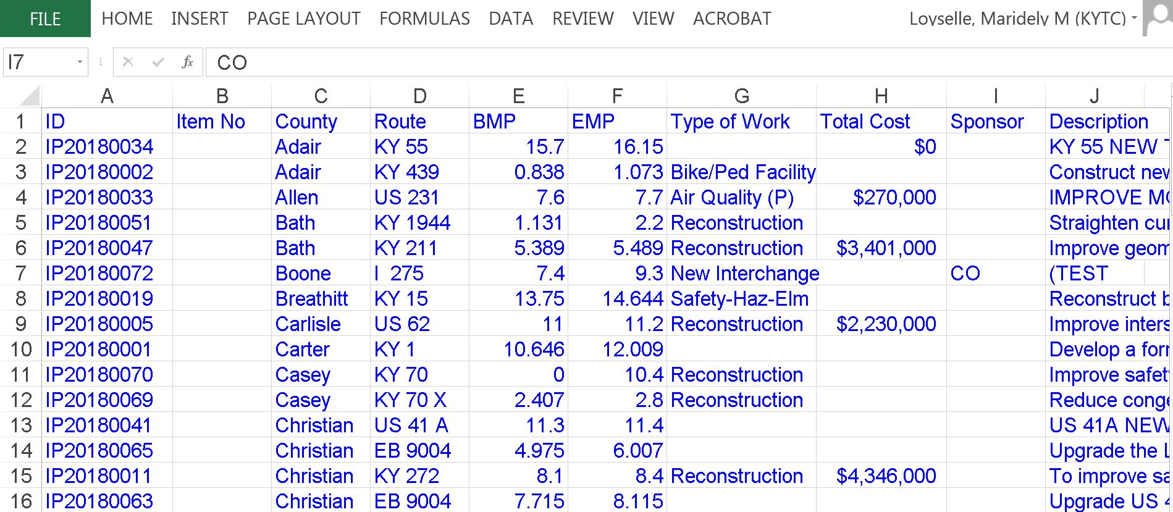
Notes:
This report will have a list of all the projects and their sponsorship status.

Slide 16
Questions?
SHIFT
Eileen Vaughan
eileen.vaughan@ky.gov
CHAF
Maridely Loyselle
Maridelly.loyselle@ky.gov

